Slide 1
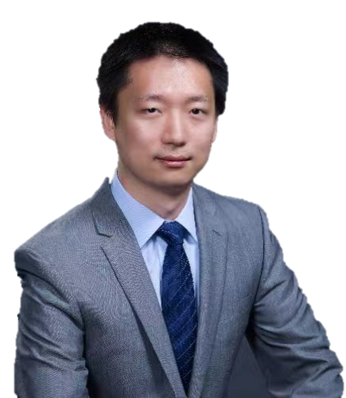


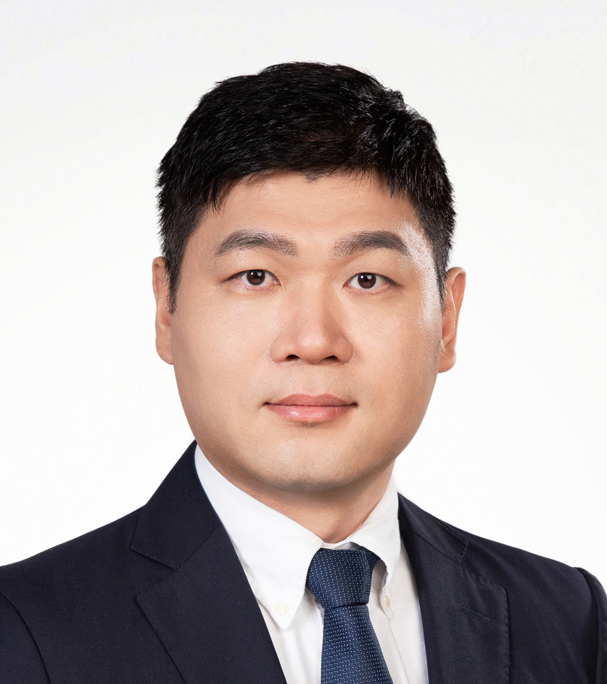
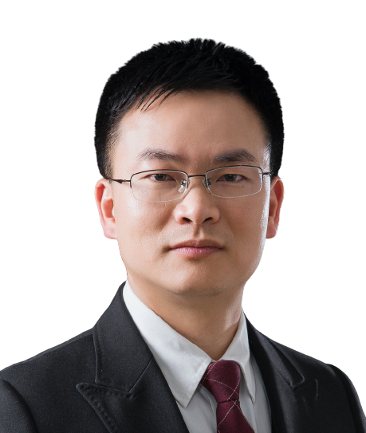
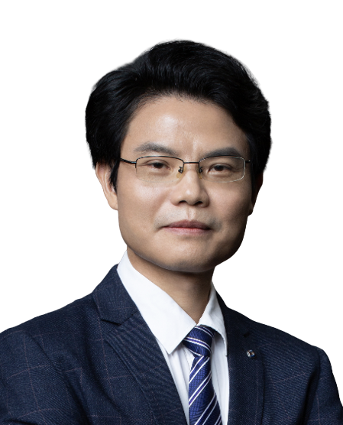
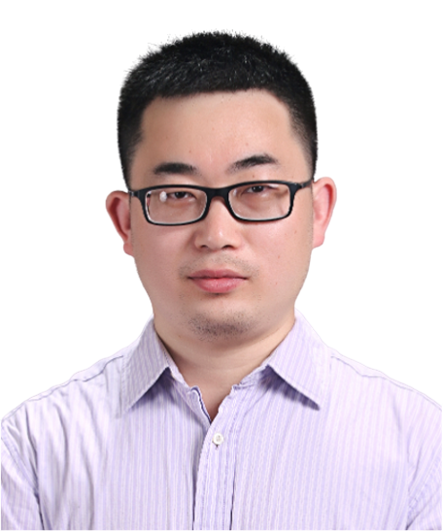
多维度生命组学解析肿瘤免疫微环境
报告时间2024-6-20 9:00-11:00
地址: B2栋, 201会议室, 广州实验室
腾讯会议：399-6661-4494 Bilibili：https://live.bilibili.com/26427894
韩大力
中国科学院 研究员
汇报人简介:
韩大力，国家生物信息中心计算生物学部部长，中国科学院北京基因组研究所研究员，2007年毕业于中国科学技术大学生物技术专业，2012年获得中科院遗传发育所生物信息学博士学位。2012-2017年赴美国芝加哥大学从事博士后研究。2017年9月回国加入中科院北京基因组研究所（国家生物信息中心）组建独立研究团队。主要研究领域是通过多维度生命组学解析肿瘤免疫微环境，受基金委优青项目支持，入选国家百千万人才工程和国务院政府特殊津贴，获首届钟南山青年科技创新奖。
韩大力研究员应用表观组学技术、化学生物学工具和生物信息学方法研究RNA修饰调控机制。逐渐形成利用RNA表观组学、单细胞转录组学和空间转录组学相结合的特色研究体系,取得系列性前沿进展：在调控理论方面，揭示caRNA m6A修饰直接影响染色质结构和组蛋白修饰的转录调控新机制；在致病机制方面，系统性解析肿瘤微环境中肿瘤细胞、树突状细胞、巨噬细胞和T细胞的功能失调和RNA修饰异变机制，鉴定多个免疫治疗新靶点并开发小分子抑制剂;在组学技术方面，开发多种核酸修饰的测序新技术和数据分析策略。在Nature、Science、Cancer Cell、Cell Metabolism等期刊发表通讯作者论文10篇（含共同通讯），第一作者（含共同第一）论文8篇和其它作者论文12篇。他引总数7000余次。应邀在权威综述杂志Annual review of immunology回顾和点评领域进展。
HOST＆PANELISTS
Host：Zhichao Miao
Guangzhou Laboratory
Guangzhou Medical University
Lin Huang
Sun Yat-sen University
Jianhua Yang
Sun Yat-sen University
Jinkai Wang
Sun Yat-sen University

Slide 2

Multi-omics analysis of the tumor immune microenvironment
Time (China): 2024-6-20 9:00-11:00
Address: Building B2, 201 room, Guangzhou Laboratory
Tencent Meeting: 399-6661-4494 Bilibili：https://live.bilibili.com/26427894
Dr. Dali Han
Chinese Academy of Sciences
Introduction:
Dr. Dali Han applies epigenetic techniques, chemical biology tools, and bioinformatics methods to study the regulatory mechanisms of RNA modification. He has gradually formed a characteristic research system that combines RNA epigenomics, single-cell transcriptomics, and spatial transcriptomics, achieving a series of cutting-edge progresses: In terms of regulatory theory, he has revealed new transcriptional regulatory mechanisms of chromatin structure and histone modifications directly affected by caRNA m6A modification; In terms of pathogenic mechanisms, he has systematically analyzed the functional dysregulation and RNA modification abnormalities in the tumor microenvironment, including tumor cells, dendritic cells, macrophages, and T cells, identified multiple new targets for immunotherapy and developed small molecule inhibitors; In terms of omics technology, he has developed new sequencing technologies and data analysis strategies for nucleic acid modifications. He has published 10 papers as corresponding author (including co-corresponding) in journals such as Nature, Science, Cancer Cell, and Cell Metabolism, 8 papers as first author (including co-first), and 12 papers as other authors. His work has been cited over 7000 times. He has been invited to review and comment on the progress in the field in authoritative review journals such as Annual Review of Immunology.
HOST＆PANELISTS
Host：Zhichao Miao
Guangzhou Laboratory
Guangzhou Medical University
Lin Huang
Sun Yat-sen University
Jianhua Yang
Sun Yat-sen University
Jinkai Wang
Sun Yat-sen University

